Slide 1


Citation Networks Evolution Using Dynamic Network Embeddings
Shay Bistrizky
Avishay Bar
Students
316165984
206622086
Dr. Renata Avros
Supervisors
Prof. Zeev (Vladimir) Volkovich
Notes:
Good morning, everyone, and welcome to our final project presentation.
Me, Avishay Bar and my teammate Shay Bistrizky, are excited to present our work on "Citation Networks Evolution Using Dynamic Network Embeddings."
This project was conducted as part of the Software Engineering Department at Braude College, under the supervision of Dr. Renata Avros and Prof. Zeev (Vladimir) Volkovich.
Throughout this presentation, we will introduce our topic and explain our approach.

Slide 2
Project Overview
In this project, we aim to classify and analyse citation behaviours within dynamic citation networks. By understanding these patterns, we can gain insights into how knowledge propagates, how influential research emerges, and how academic discourse evolves over time.
Perform
Analyze
Perform citation classification for deeper scholarly insights
Develop
Analyze dynamic network embeddings
Develop a model for embedding dynamic citation networks.
The aim is to identify citations within the dynamic networks that exhibit classification-relevant behaviours and develop a validated framework to confirm these observations. This provides a systematic approach to understanding and verifying citation dynamics in evolving scholarly landscapes.
Notes:
Now, let's go over the overview of our project.
Our goal in this research is to classify and analyze citation behaviors within dynamic citation networks. Citation networks represent how scientific knowledge propagates over time through references between academic papers. By studying these patterns, we can gain insights into:
How influential research emerges,
How knowledge spreads across disciplines, and
How academic discussions evolve over time.
To achieve this, our approach consists of three main steps:
Firstly Develop – We design and implement a model that embeds citation networks dynamically. This means we don't just take a static snapshot but capture how the structure evolves over time.
Secondly Analyze – We analyze dynamic network embeddings to identify patterns and draw conclusions about certain citations within the network. This allows us to track the influence of research articles and detect key trends in academic evolution.
Lastly Perform – We classify different types of citations based on their impact due to the analysis outputs.
Ultimately, the goal of this framework is to provide a systematic way to track the dynamics of scientific knowledge. Understanding these citation behaviours can help researchers make better decisions about emerging research trends.

Slide 3
Road Map
Introduction
1
Research Objectives
2
Background
3
Approach
4
Model Flowchart
5
Conclusion
6
Notes:
Before diving into the details of our project, let me give you an overview of our presentation structure.
This road map outlines the key sections we will cover:
Introduction – We will start with a brief explanation of citation networks.
Research Objectives – We will define our main goals.
Background – We will define the models we chose to achieve the study.
Approach – This section will describe our methodology.
Model Flowchart – We will present a structured diagram of our model to illustrate how the different components interact.
Conclusion – Finally, we will summarize study.

Slide 4
Road Map
Introduction
1
Research Objectives
2
Background
3
Approach
4
Model Flowchart
5
Conclusion
6

Slide 5

Introduction
Significance of Highly Cited Articles
Dynamic Networks and Embeddings
Shaping research priorities, fostering collaboration, and driving innovation.
Use embeddings to track changes, reveal trends, and identify key works.
Static Analysis Limitations
Dynamic Citation Analysis
Limitations in capturing temporal changes, identifying trends, and predicting dynamics.
Classify citation articles through embedding analysis.

Slide 6
Citation Dynamic Network Nature
Irreversibility of Edges
Node Longevity
Citations are permanent and unidirectional, highlighting the enduring impact of foundational works.
Articles remain relevant for years, anchoring the evolving research landscape.
Hierarchical Structure of Influence
Citation Burstiness
Citation networks flow hierarchically, with older works as "roots" and newer works building on them.
Citations surge with trends, paradigm shifts, or discoveries, highlighting research focus shifts.

Slide 7
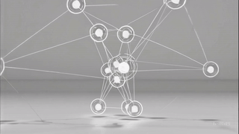

Slide 8
Road Map
Introduction
1
Research Objectives
2
Background
3
Approach
4
Model Flowchart
5
Conclusion
6

Slide 9
Project Objectives
The approach focuses on three interconnected objectives providing a comprehensive understanding of citation networks:
Dynamic Networks Evolution
Identify Patterns
Examine structure and evolution over time using a dynamic embedding approach.
Develop Scalable Models
Analyze node classifications within the citation dynamic network and be able to validate the results.
Create an efficient embedding model for large-scale analysis.
Notes:
Our approach is based on three key objectives that provide a comprehensive understanding of citation networks:
Develop Scalable Models – We aim to create an efficient embedding model that can handle large-scale citation networks while maintaining accuracy and computational efficiency.
Identify Patterns – By analyzing dynamic networks embeddings, we can detect trends in citation behaviors and validate how different research papers influence the network.
Dynamic Networks Evolution – We examine how the structure of citation networks changes over time using dynamic embedding techniques to track the rise and decline of influential papers.
These objectives form the foundation of our research and drive our methodology. Now, let’s move on to the background of our study.

Slide 10
Road Map
Introduction
1
Research Objectives
2
Background
3
Approach
4
Model Flowchart
5
Conclusion
6

Slide 11
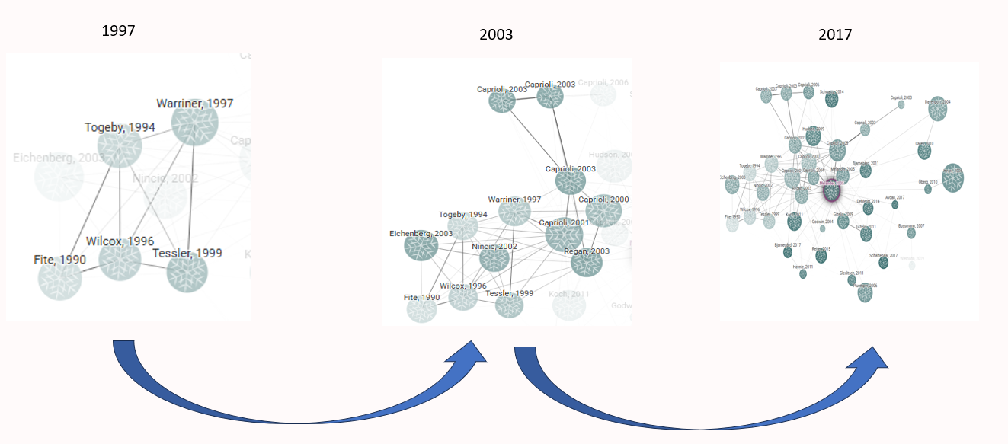
Dynamic Networks
1
Static Networks
2
Dynamic Networks
3
Temporal Changes
Static networks capture connections at a single point in time, lacking the evolution of relationships.
Dynamic networks capture evolving connections over time, showing how relationships change.
Key factors are node proximity and temporal continuity, showing closeness and consistent representation over time.

Slide 12
Dynamic Bernoulli Networks Embeddings
Dynamic Bernoulli embeddings are a novel approach in dynamic network analysis aiming to expose the proximity and temporal continuity of nodes in a dynamic network. Dynamic Bernoulli embeddings are based on random walks to generate sequences of nodes.
Random Walk
1
Track the sequential context of nodes within the dynamic network.
Calculating Loss using Negative Sampling
2
Calculate loss elements and utilizing negative sampling.
3
Loss Optimization
Minimize the loss function using the SGD algorithm.
Context Update
4
Updating context vector to each node in the temporal graph.
Notes:
Now, let’s dive into Dynamic Bernoulli Network Embeddings. This is a novel approach for analyzing dynamic networks.
This method is designed to preserve both proximity and temporal continuity of nodes in evolving networks. It achieves this by generating node sequences using random walks and refining their representations over time.
The process consists of four key steps:
Random Walk – This step tracks the sequential context of nodes within the dynamic network, helping to capture relationships between connected entities. Lets dive a little bit into that model.
Calculating Loss using Negative Sampling – Instead of computing all possible relationships, we optimize learning by selectively sampling negative examples that help distinguish relevant connections. Shay is going to explain that model.
Loss Optimization – We minimize the loss function using the Stochastic Gradient Descent (SGD) algorithm, ensuring that embeddings effectively capture evolving patterns in the network.
Context Update – Finally, we update the context vector for each node in the temporal graph, allowing the model to maintain continuity over time.
By combining these steps, Dynamic Bernoulli Embeddings create a robust framework for understanding the evolution of dynamic networks, allowing us to do some calculation manipulations on the given embeddings.

Slide 13
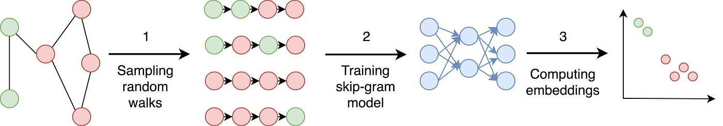
Random Walks for Network Exploration
What is a Random Walk?
Key Advantages
A random walk is a stochastic process that generates a path through a graph. At each step, the next node is chosen randomly from the current node's neighbors.
Enabling efficient sampling of large networks, especially when global computations are impractical or computationally expensive.
Random Walk vs. Probability
Each step to a neighbouring node is determined by probabilistic transitions. These probabilistic movements capture the co-occurrence frequencies of nodes, which are then leveraged to learn robust low-dimensional embeddings.
Notes:
What is a Random Walk?
A random walk is a process where we move through a graph by randomly selecting the next node from its neighbours. This allows us to capture connections and structures within the network.
Why Use Random Walks?
We assume that the network is extremely large. So, instead of analysing the entire network, we use probabilistic transitions to sample node sequences. This helps us learn meaningful embeddings while keeping computations efficient.
As shown in the diagram, we:
Sample random walks to create node sequences.
Train a skip-gram model (which is an inner model) to learn relationships.
Compute embeddings, mapping similar nodes closer together.
By leveraging random walks, we can effectively analyse citation networks and track their evolution.
Let's return to the dynamic Bernoulli embeddings model.

Slide 14
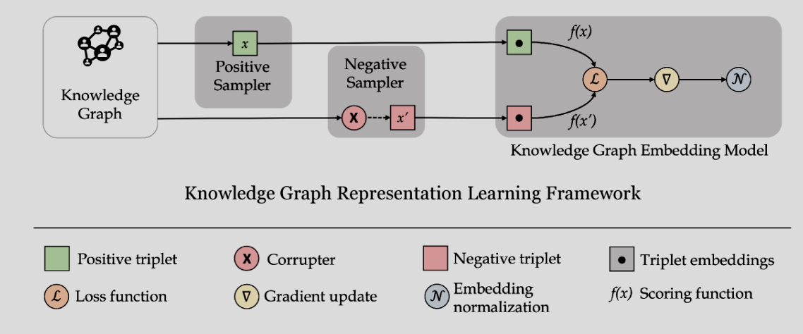

Learning Graphs By Sampling
Negative sampling is a pivotal technique for training embeddings in dynamic networks, as it helps algorithms distinguish real connections from noise at each time step. By selectively sampling non-existent edges, it reduces computational overhead and enhances the model’s ability to capture evolving relationships.
Citation
Graph
Citation Graph Embedding Model
$$ℒ =ℒ_{α}+ℒ_{pos}+ℒ_{neg}+ℒ_{y}$$
Citation Graph Representation Learning Framework

Slide 15
Road Map
Introduction
1
Research Objectives
2
Background
3
Approach
4
Model Flowchart
5
Conclusion
6

Slide 16


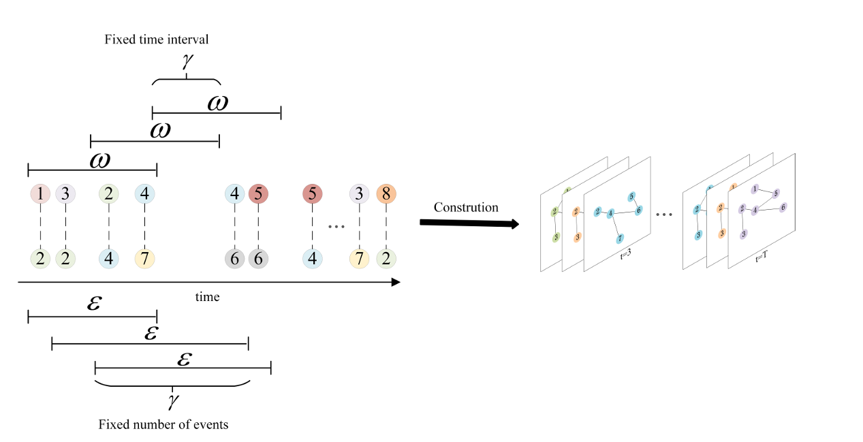
Approach
In a dynamic citation network, each article is represented as a node, and a directed edge signifies a citing. Over time, new papers and citation links are added, capturing the evolving nature of academic influence and knowledge transfer. Two strategies for constructing the dynamic citation network :
Fixed Time Interval
Fixed Event Count
Create snapshots at regular time intervals, like monthly or yearly.
Construct networks by dividing them into snapshots, each containing a fixed number of citation events, ensuring uniform density while remaining independent of time intervals.
Notes:
Now, let’s talk about our approach for constructing a dynamic citation network.
Each article is represented as a node, and each citation forms a directed edge between two nodes. As time progresses new citation links are added.
There are two main strategies to structure this network:
Fixed Time Interval based on snapshots at regular time intervals, such as monthly or yearly. This helps track long-term citation trends and understand how research influence changes over time.
Fixed Event Count – Instead of using time-based intervals, we create snapshots based on a fixed number of citation events. This ensures that each snapshot has a uniform density, making it easier to compare citation patterns without being affected by irregular publishing cycles.
To maintain continuity and smooth transitions between snapshots, we take an overlap between consecutive snapshots. This overlap helps us preserve relationships between citations across different snapshots, preventing disruptions in the network’s structure and ensuring that important trends are not lost.

Slide 17

Node Classification
Emerging Nodes
Nodes with recently increasing citations.
Rising Stars (Sleeping Beauty)
Emerging nodes with significant growth.
Steady Nodes
Nodes with consistent citation activity.
Falling Stars
Nodes with declining citation activity.

Slide 18
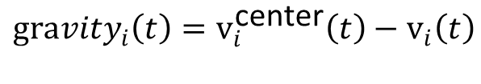
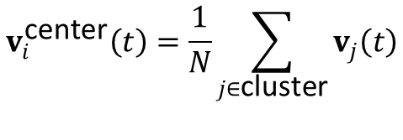
Classification Evaluation
Connectivity in dynamic networks is the ability to maintain communication despite changing topology.
The centroid in dynamic networks minimizes total distance to all nodes as topology changes.
Emerging Nodes
Steady Nodes
Rapid increase in connectivity
Steady connectivity over time
Rising Stars
Falling Stars
High gravity to centroid
Low gravity to centroid
$$v_{i}^{\text{center}}\left(t\right)=\frac{1}{N}\sum_{j∈\text{cluster}}{v_{j}\left(t\right)}$$
$$Δv_{i}=∥v_{i}\left(t+Δt\right)−v_{i}\left(t\right)∥$$
$$v_{i}−node embedding vector in graph i \\ N −number of nodes in the cluster$$
$${gravity}_{i}\left(t\right)=v_{i}^{\text{center}}\left(t\right)−v_{i}\left(t\right)$$

Slide 19
Road Map
Introduction
1
Research Objectives
2
Background
3
Approach
4
Model Flowchart
5
Conclusion
6

Slide 20
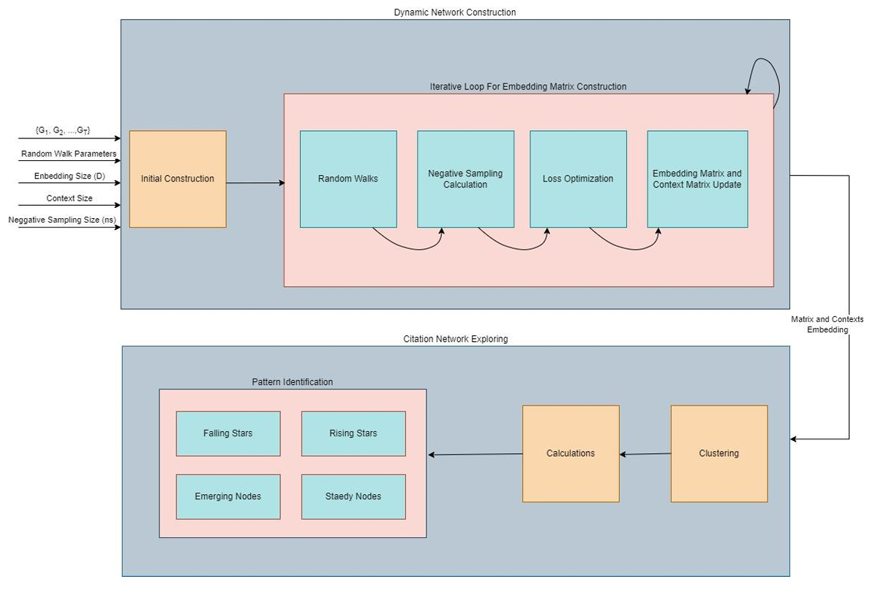
Project Flowchart
Initial Construction
Dynamic Bernoulli Embeddings
Clustering & Calculations
Pattern Identifications
Notes:
Now, let’s go over the flowchart that represents the structure of our approach.
Our process consists of four main stages, each contributing to the construction and analysis of the dynamic citation network:
Initial Construction – We begin by defining the citation network, setting parameters such as random walk settings, embedding size, context size, and negative sampling size.
Dynamic Bernoulli Embeddings – We use random walks to explore node relationships, apply negative sampling to improve learning efficiency, optimize loss functions, and update embedding matrices iteratively.
Clustering & Calculations – Once embeddings are generated, we apply clustering techniques to group similar nodes and perform various calculations to analyze patterns and relationships.
Pattern Identifications – Finally, we classify nodes into different categories such as Falling Stars, Rising Stars, Emerging Nodes, and Steady Nodes. This helps us understand the evolution of research influence over time.
By following this structured approach, we aim to a mother that accurately captures citation dynamics and provides meaningful insights into how research trends evolve.

Slide 21
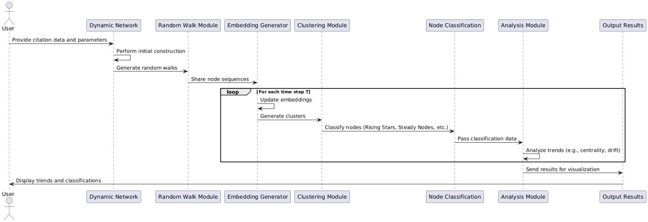
Sequence Diagram

Slide 22
Testing Plan
Unit Under Test | Test Case | Input | Expected Output
Dynamic Network | Network Construction with Fixed Time Intervals | Citation data split into yearly intervals. | Correctly structured networks for each year, with accurate nodes and edges.
 | Network Construction with Fixed Event Counts | Citation data with a specified number of events per snapshot. | Uniformly dense networks with appropriate overlaps.
Random Walk | Random Walks on Static Graphs | A static graph with defined edges. | Correct sequences capturing both local and global structures.
 | Random Walks on Dynamic Graphs | A dynamic graph with changing nodes and edges. | Sequences adapting to graph changes over time.
Embedding Generator | Embeddings for Static Nodes | Nodes with consistent relationships over time. | Stable embeddings with minimal drift.
 | Embeddings for Evolving Nodes | Nodes with rapidly changing connectivity. | Embeddings reflecting the change in proximity and influence.
Calculation and Classification | Classification of Rising Stars | Nodes with increasing centrality and connectivity. | Nodes correctly categorized as Rising Stars.
 | Classification of Falling Stars | Nodes with declining centrality and connectivity. | Nodes correctly categorized as Falling Stars.
 | Classification of Emerging and Steady Nodes | Nodes with new or consistent citation activity. | Accurate classification as Emerging or Steady Nodes.

Slide 23
Road Map
Introduction
1
Research Objectives
2
Background
3
Approach
4
Model Flowchart
5
Conclusion
6

Slide 24



Future Steps
Approach Implementation
Citations Classification
Validation and Testing
Implement the proposed dynamic embedding framework approach and testing on real-world citation data.
Develop an efficient framework for node classification using the implemented approach.
Validate the framework's effectiveness by analyzing diverse citation networks.

Slide 25

Questions

Slide 26


